Slide 1
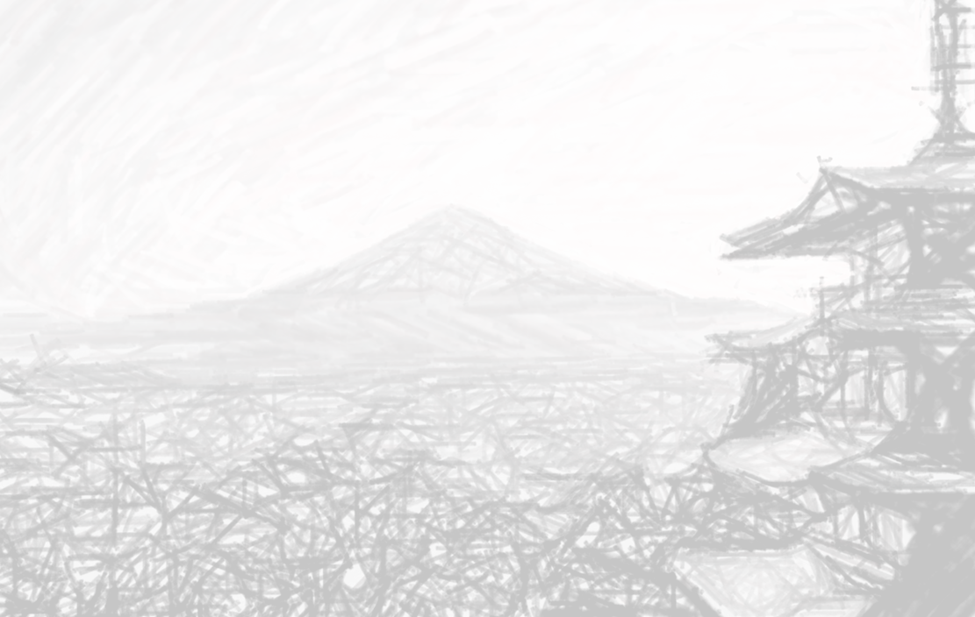

Information Geometry: An Invitation for Machine Learning
Frank NIELSEN
Sony Computer Science Laboratories Inc.
Tokyo, Japan
https://franknielsen.github.io/
@FrnkNlsn
NeurIPS meetup Japan
December 2021
Notes:
https://neuripsmeetup.jp/2021/

Slide 2

Outline of this talk
Introduction
ML & Computational Geometry: A long and fruitful history!
Fisher-Rao information geometry
Natural-gradient descent
2. Bregman information geometry Chernoff information on the exponential family manifold
Perspectives: Large-scale singular NN/ML models
Notes:
(Levi-Civita connection)
(Two dual connections)

Slide 3
Introduction:
Machine Learning & computational geometry:
A long and fruitful history from the start!

Slide 4
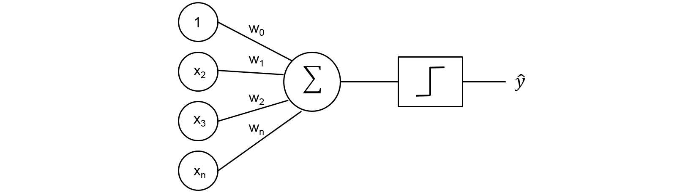
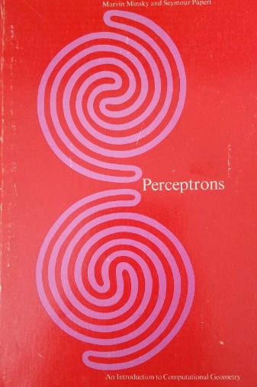
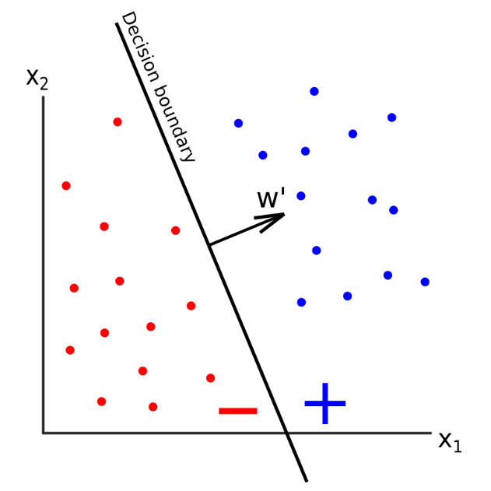
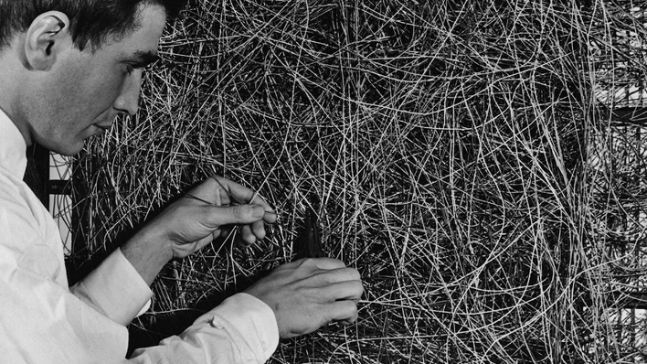
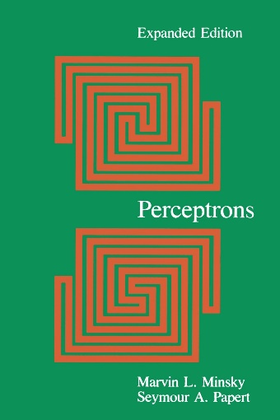
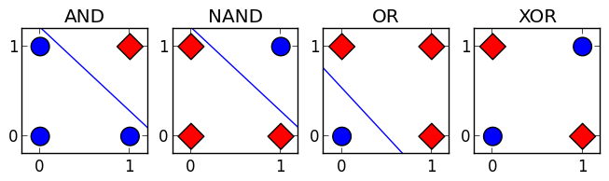

Learning machines: Perceptron & geometry (1960’s)
Decision boundary:
geometric hyperplane separator
MIT Press, 1969
XOR cannot be learned… NN winter…
Connectionism machine
≠ von Neumann machine
MIT Press, 3rd 1987
Connectedness…
1969
Marvin Minsky and Seymour Papert:
Perceptrons: An Introduction to Computational Geometry, 1969
Notes:
https://jtsulliv.github.io/perceptron/
https://mitpress.mit.edu/books/perceptrons
https://towardsdatascience.com/perceptron-explanation-implementation-and-a-visual-example-3c8e76b4e2d1
https://en.wikipedia.org/wiki/Perceptrons_(book)
https://en.wikipedia.org/wiki/Perceptrons_(book)

Slide 5
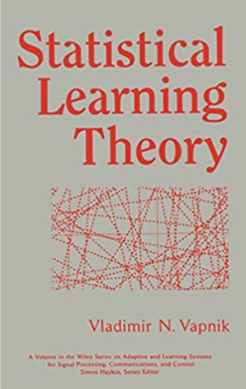
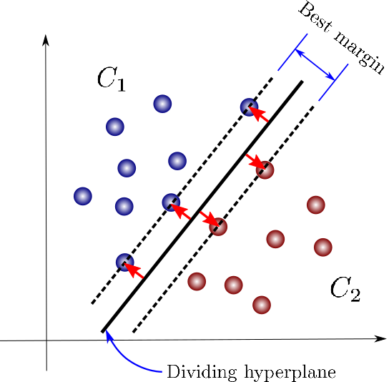
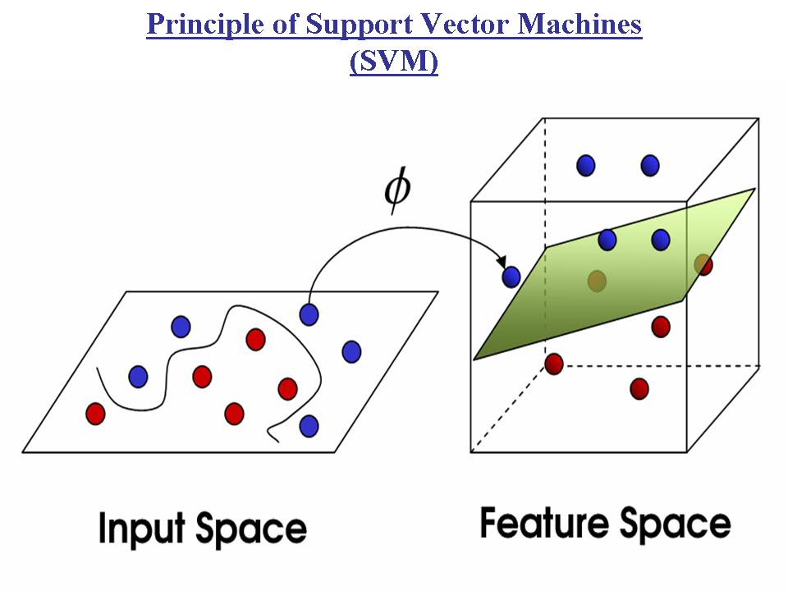
Geometric learning machines: SVMs (1970’s/1992)
Linear separator
Non-linear separator
(Kernel trick, RKHS)
Support vector
1998
Feature map
Inner product
(Hilbert space)
1970
1992
Kernel machines
Theory of VC-dimension = expressive power of (geometric) separators

Slide 6
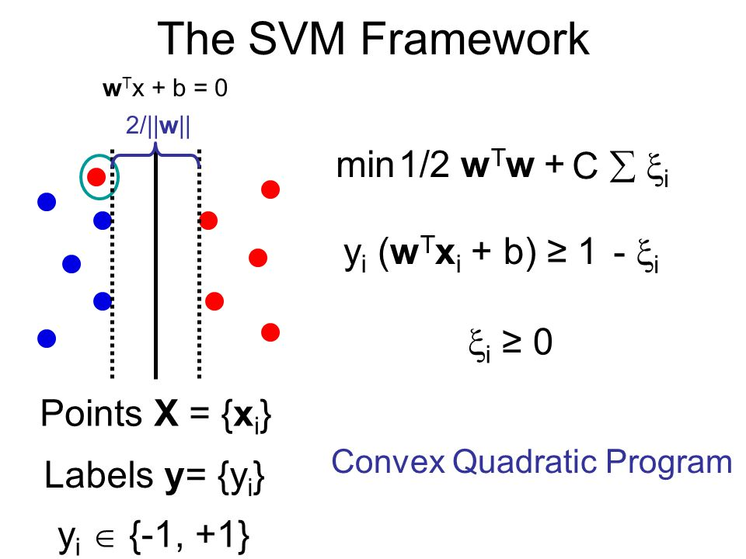
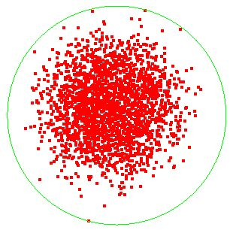
Dual SVM quadratic program amounts to solve a Smallest Enclosing Ball (= SEB): Computational geometry !
Widest margin hyperplane separator
Smallest enclosing ball:
``Smallest’’ ball with respect to
radius or set inclusion
Approximating Smallest Enclosing Balls with Applications to Machine Learning, IJGA 2009
Notes:
https://phazcode.gitlab.io/meb/

Slide 7
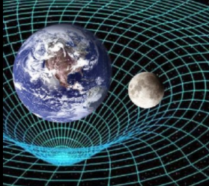
Information geometry in a nutshell
Born as a mathematical curiosity [Hotelling 1930] [Rao 1945]
Impacted by the success of Riemannian geometry in Einstein’s general relativity (GR)
Information geometry studies the geometric structures and statistical invariance (sufficient statistics/Markov kernels) of a family of probability distributions: the statistical model
+ demonstrate its use in information sciences: statistics, ML, etc.
Geometric method: coordinate-free objects with computing operating in (local) coordinate systems: free to choose coordinates to ease the computations!
Dualistic structures pioneered by Prof. Shun-ichi Amari & statistical invariance pioneered by Chenstov
[Amari 1985] [Amari & Nagaoka 2000] [Amari 2016] [Chentsov 1982]

Slide 8
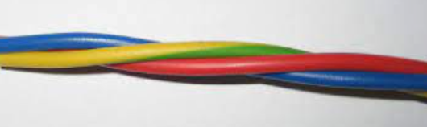
statistics
divergence
geometry
models
The fabric of information geometry
and the untangling of its geometry, divergence, statistical models
1. Fisher-Rao information geometry
Riemannian geometry
Notes:
Twisted cable

Slide 9
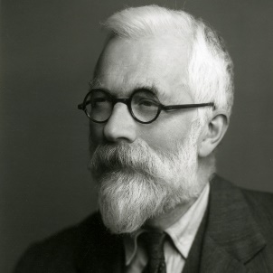
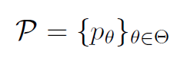
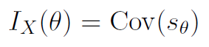
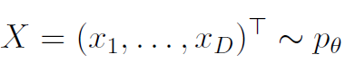
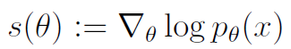
Fisher information matrix (FIM)
A parametric family of distributions
Fisher information matrix is positive-semidefinite matrix:
FIM = Covariance of the score:
Score:
Under independence, Fisher information is additive:
Positive
semi-definite matrix
Notes:
Fisher information matrix is defined as the covariance of the score.
FIM is additive for random vectors with independent random variables.
It can be singular (hierarchical models like mixtures/NNs) and even infinite
https://arxiv.org/abs/1301.3578
-----
$$
X=(x_1,\ldots,x_D)^\top\sim p_\theta
$$
$$
\mathcal{P}=\{p_\theta\}_{\theta\in\Theta}
$$
$$
I_X(\theta)=[I_{ij}(\theta)]_{ij}\succeq 0, \quad I_{ij}(\theta):=\Cov_{p_\theta}(x_i,x_j)
$$
$$
Y=(Y_1,\ldots,Y_n)_{\sim_{\mathrm{iid}} p_\theta}\quad \Rightarrow\quad I_Y(\theta)=n\,I_X(\theta)
$$
$$
I_1(\theta)=E_{p_\theta}\left[(\nabla_\theta \log p_\theta) (\nabla_\theta \log p_\theta)^\top\right]
$$
$$
I_2(\theta)= -E_{p_\theta}\left[\nabla^2_\theta \log p_\theta\right]
$$

Slide 10
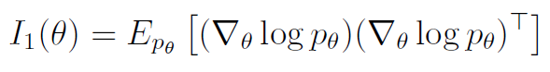
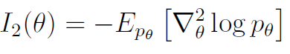

Fisher information matrix
Under regularity conditions I = FIM type 1 :
Under regularity conditions II = FIM type 2 :
FIM can be singular in hierarchical models like mixtures & neural networks
FIM can be infinite (irregular models, e.g., support depend on parameter)
Difficult to estimate FIMs for NNs:
Spectral FIM properties from random matrix theory RMT), relative FIM
Sun & N, Relative Fisher information and natural gradient for learning large modular models, ICML 2017
Soen and Sun, On the Variance of the Fisher Information for Deep Learning, NeurIPS 2021

Slide 11
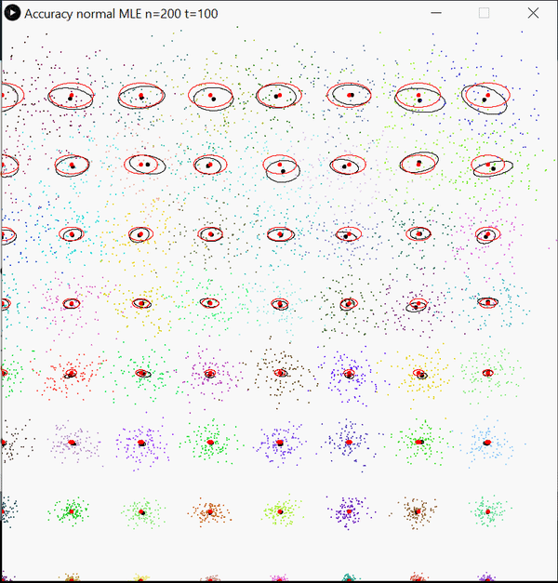
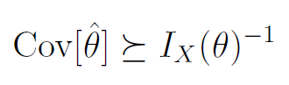
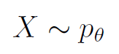
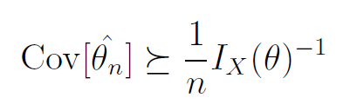
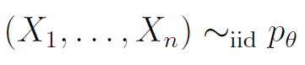
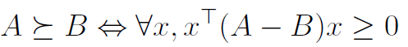
Fisher information and Cramér-Rao lower bound
The covariance of any unbiased estimator is lower bounded by
Since Fisher information is additive:
Accuracy estimators depend on model parameters: Fisher efficiency
Inverse Fisher Information Matrix (IFIM)
Non-asymptotic
Empirical estimator covariance matrix
IFIM (Tissot indicatrix)
N., Cramér-Rao lower bound and information geometry, Connected at Infinity II, 2013

Slide 12
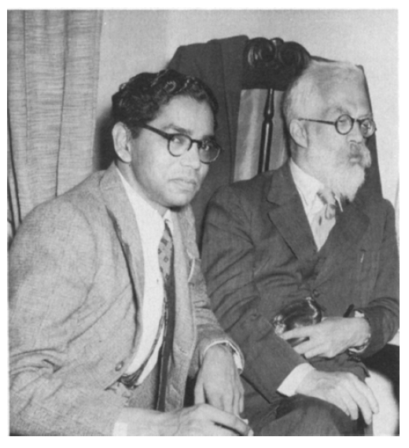
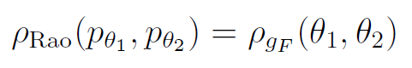
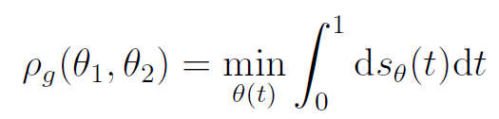
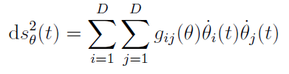
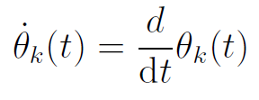
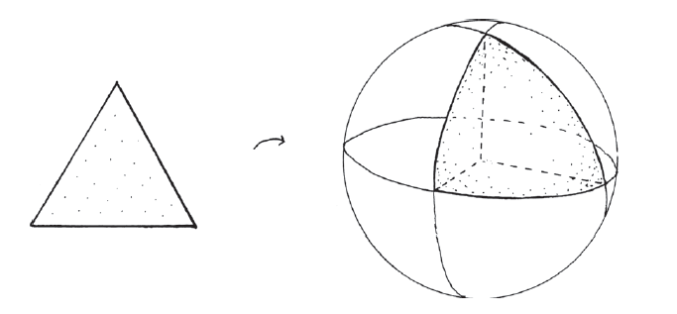
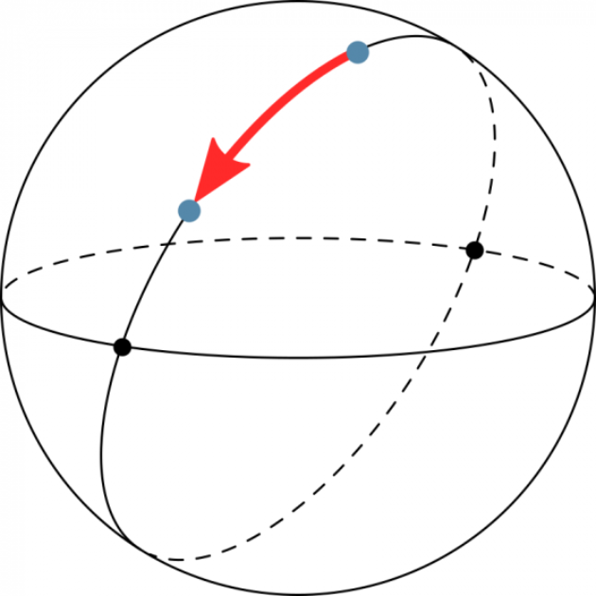
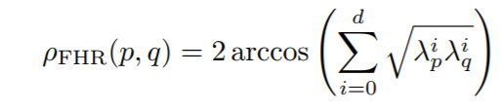
Rao’s length distance: Riemannian metric distance
(M,g_{F}): Riemannian manifold
Parameter space equipped with the Fisher information metric g_{F}
C. R. Rao with
Sir R. Fisher in 1956
⟶ need to calculate Riemannian geodesics θ(t):
….characterized as (locally) shortest curves in Riemannian geometry
For example, Rao distance in the probability simplex:
Square root
embedding
Positive orthant
of the sphere
Standard simplex
Notes:
https://demonstrations.wolfram.com/PseudosphereGeodesics/
Invariant under smooth & bijective reparameterization
E.g., normal family: (μ,σ), (μ,σ²), (μ,log σ)
FIM is covariant under reparameterization

Slide 13
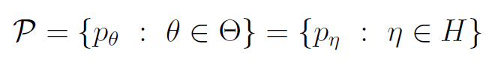
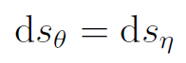
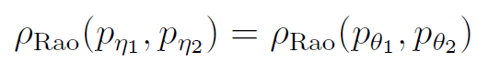
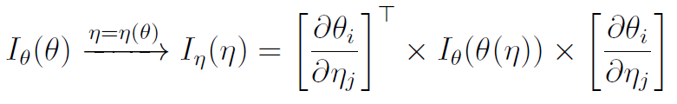
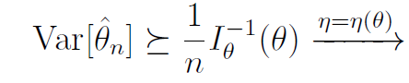
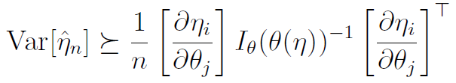
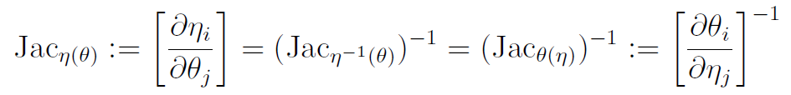
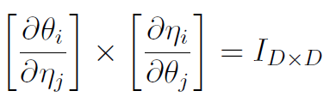
Reparameterization of the statistical model: Invariance, covariance and contravariance
Smooth reparameterization of the model:
The line element ds is invariant and hence Rao distance is invariant:
Fisher information matrix is covariant:
Cramér-Rao bound is contravariant:
Jacobian calculus:

Slide 14
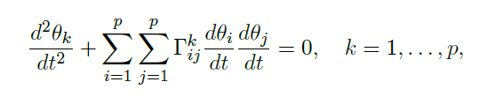
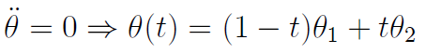
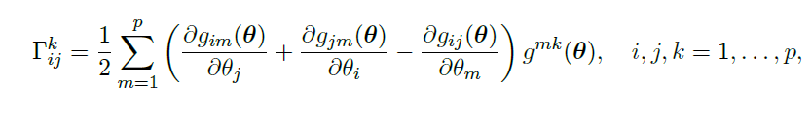
In practice, calculating Rao’s distance can be difficult!
No closed form of Rao’s distance between multivariate normals! (MVNs)
Two reasons for intractability:
Need to solve the Ordinary Differential Equation (ODE) for finding the geodesic:
2. Need to integrate the infinitesimal length elements ds along the geodesics
But easy to solve
when Γ=0:
Line segments!
⟶ use the Levi-Civita connection derived from the metric tensor g
In general, geodesics depend on choice of the connection via Γ.
Notes:
https://golem.ph.utexas.edu/category/2018/05/the_fisher_metric_will_not_be.html
http://robotics.snu.ac.kr/fcp/files/_pdf_files_publications/201312_DTI%20Segmentation.pdf
https://www.researchgate.net/publication/282538992_Geodesic_Hypothesis_Testing_for_Comparing_Location_Parameters_in_Elliptical_Populations

Slide 15
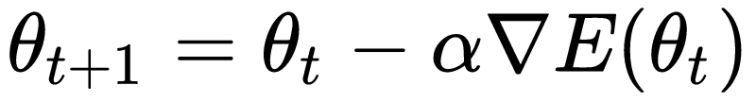
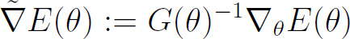
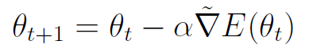
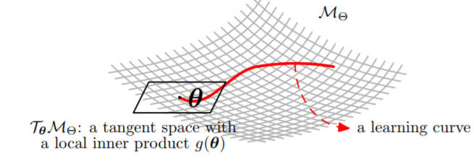

Natural-gradient descent: Steepest Riemannian descent
Ordinary gradient descent:
Covariant gradient:
Type mismatch on (M,g)
depends on the choice of the parameterization
plateau phenomena near singularities
Contravariant gradient
Natural gradient descent with natural gradient :
NG invariant to reparameterization:
avoids plateaus
Amari, Natural gradient works efficiently in learning." Neural computation, 1998
Sun & N, Relative Fisher information and natural gradient for learning large modular models, ICML 2017
Li et al., Tractable structured natural gradient descent using local parameterizations, ICML 2021

Slide 16




First-principle of geodesics: Affine connections
Riemannian geodesics are locally minimizing length curves
General definition of geodesics is wrt. to an affine connection:
For Riemannian geodesics, the default connection = Levi-Civita connection.
This special Levi-Civita connection is derived from the metric tensor g.
A geodesic γ(t) with respect to a connection ∇ is an ∇-autoparallel curve
In physics, “straight” free fall particle
where ∇_{X}T is the covariant derivative of a tensor T wrt. a vector field X
[EIG 2020] An elementary introduction to information geometry, Entropy 22.10 (2020)

Slide 17



What makes the Levi-Civita connection so special?
An affine connection ∇ defines how to ∇-parallel transport a vector from one tangent plane to another tangent plane
Fundamental theorem of Riemann geometry:
Levi-Civita connection is the unique torsion-free metric connection induced by the metric tensor g
Metric compatible
Levi-Civita connection
[EIG 2020]

Slide 18



Affine connection ∇:
Curvature & parallel transport on infinitesimal loops
Élie Cartan
1869-1951
Cylinder is flat:
Parallel transport is
independent of path
Sphere has constant curvature:
Parallel transport is path-dependent
A connection is flat is there exists locally a coordinate system θ such that the Christoffel symbols Γ are all zero: Γ(θ)=0
⟶ Geodesics plotted in that coordinate system are line segments
Notes:
https://images.math.cnrs.fr/Visualiser-la-courbure.html?lang=fr

Slide 19







Dualistic information geometry:
Given an affine torsion-free connection ∇ and a metric g, we can build a unique dual affine torsion-free connection: the dual connection ∇* such that the metric (inner product) is preserved by the primal and metric-compatible dual parallel transports:
This amounts to say that ∇* is defined uniquely by geometric equation:
The dual of a dual connection is the primal connection:
Meaning for each point p of M:
[EIG 2020]

Slide 20





Statistical invariance wrt sufficient statistics
A statistic is a function of a random vector (e.g., mean, variance)
A sufficient statistic collect and concentrate from a random sample
all necessary information for estimating the parameters.
Informally, a statistical lossless compression scheme…
Definition: conditional distribution of X given t does not depend on θ
Fisher-Neyman factorization theorem: Statistic t(x) sufficient iff. the density can be decomposed as:
Example: Normal distributions have D=2 sufficient statistics:
t=T(X) contains all
Information about θ
Statistical exponential families: A digest with flash cards, arXiv:0911.4863 (2009)

Slide 21




Natural exponential families: Finite sufficient statistics
Consider a positive measure (usually counting or Lebesgue)
A natural exponential family is a parametric family of densities that write as
where F is real-analytic, strictly convex and differentiable:
F: Log-normalizer (also known as log partition function or cumulant function)
Sufficient statistic
T(X)=X
Natural parameter space
Barndorff-Nielsen, Information and exponential families: in statistical theory. John Wiley & Sons, 2014
Sundberg, Statistical modelling by exponential families. Vol. 12. Cambridge University Press, 2019
N., Garcia, Statistical exponential families: A digest with flash cards." arXiv:0911.4863

Slide 22

Many common distributions are exponential families in disguise…
Exponential
families
… Once you relax natural EFs
to be general exponential families
Statistical exponential families: A digest with flash cards, arXiv:0911.4863 (2009)
Tojo and Yoshino, On a method to construct exponential families by representation theory, GSI 2019 (Springer)

Slide 23



Exponential families: From Natural EFs to simply Efs!
Consider a (sufficient) statistic t(x), model order D, d-variate densities
Consider an additional carrier measure term k(x)
Consider an inner product between t(x) and θ
(usual scalar/dot product)
Properties:
Sufficient statistic
t(X)
Exponential families have finite moments of any order
Hessian of –log p_{θ}(x):
This is FIM of type 2
Notes:
\def\inner#1#2{{\langle #1, #2\rangle}}
p_{\theta}(x)= \exp(\inner{\theta}{t(x)}-F(\theta)+k(x))

Slide 24

2. Bregman manifolds:
As known as…
…Dually flat spaces in IG
2021

Slide 25

Dually flat geometry from any strictly convex function
All you need
is a C3 strictly convex function!
Bregman manifolds are not necessarily related to statistical models,
but can always be realized by a regular statistical model
Vân Lê, Hông. "Statistical manifolds are statistical models." Journal of Geometry 84.1-2 (2006)

Slide 26


Bregman divergences from strictly convex function
F(θ): strictly convex and differentiable convex function on an open convex domain ϴ
Design the Bregman divergence as the vertical gap between F(θ₁) and the linear approximation of F(θ) at θ₂ evaluated at θ₁ :
[Bregman 1967]

Slide 27





Discrete Kullback-Leibler divergence: A non-separable Bregman divergence
The KLD between two categorical distributions a.k.a. multinoulli amounts to a non-separable Bregman divergence on the natural parameters of the multinoulli distributions interpreted as an exponential family.
LogSumExp is only convex but LogSumExp₊ is strictly convex
[NH 2019]
[NH 2019] Monte Carlo information-geometric structures, Geometric Structures of Information, 2019.
Guaranteed bounds on information-theoretic measures of univariate mixtures using piecewise log-sum-exp inequalities, Entropy, 18(12), 2016

Slide 28



Legendre-Fenchel transformation: Duality
Consider a Bregman generator of Legendre-type (= proper, lower semi-continuous). Then its convex conjugate obtained from the Legendre-Fenchel transformation is a Bregman generator of Legendre type.
Legendre-Fenchel transformation applies to any multivariate function
Fenchel-Moreau’s biconjugation theorem for F of Legendre-type:
Concave programming:
[Touchette 2005] Legendre-Fenchel transforms in a nutshell
[N 2010] Legendre transformation and information geometry
Notes:
proper, lower semi-continuous, and convex function,

Slide 29






Duality regular exponential families/Bregman divergences
duality
Convex conjugate:
Maximum Likelihood Estimator = Bregman centroid for the dual convex conjugate:
Inference exponential families wrt F(θ) | Dual Bregman clustering wrt F*(η)
Maximum likelihood (MLE) | Bregman centroid
Expectation/Maximization (EM) MEF | Bregman soft clustering
Classification EM = k-MLE | Bregman k-means
Banerjee et al., Clustering with Bregman divergences, JMLR 2005
k-MLE: A fast algorithm for learning statistical mixture models, ICASSP, arxiv:2012 1203.5181
Notes:
Exponential families are in bijection with Bregman divergences:
Maximum likelihood estimator for EF = Bregman centroid for dual convex conjugate.
Expectation Maximiation for mixtures EF = dual Bregman soft clustering
Classification EM = dual Bregman hard clustering
https://tinyurl.com/EF-kMLE

Slide 30




3-parameter identity of Bregman divergences
Generalize the law of cosines for the squared Euclidean distance
yields a generalization of the Pythagorean theorem
when
On geodesic triangles with right angles in a dually flat space, Progress in Information Geometry: Theory and Applications, 2021

Slide 31


Statistical divergences between parametric models = parameter divergences
Statistical divergences between densities of a parametric model amount equivalently to (parameter) divergences between corresponding parameters:
For which statistical models and statistical divergences,
do we obtain D_{M}(θ₁ : θ₂) as a Bregman divergence?

Slide 32







Example 1: Natural exponential family models & KLD*
Parametric model with densities
Examples of natural exponential families:
Exponential distributions (continuous): p.d.f.
Poisson distributions (discrete): p.m.f.
Examples of exponential families with density
Gaussian distributions once reparameterized with natural parameters
θ(λ)=θ(μ,σ²)
We have with Bregman generator:
the log-normalizer convex real-analytic function:
On a Variational Definition for the Jensen-Shannon Symmetrization of Distances Based on the Information Radius, Entropy (2021)

Slide 33






Example 2: Mixture family models & KLD
Let 1, p₀(x), …,p_{D}(x) be (D+2) linearly independent densities
Mixture family with densities:
We have:
with the Bregman generator = Shannon negentropy:
Usually F_{M}(θ) not in closed-form…
But 2-mixture family of Cauchy distributions has closed-form!
Information geometry/reconstruction
Natural parameters
The dually flat information geometry of the mixture family of two prescribed Cauchy components, arXiv:2104.13801

Slide 34






Bregman information geometry: Bregman manifolds
Start from a potential function F(θ)
Get the dual potential function F*(η)
Define the primal flat connection:
Define the dual flat connection:
Get the dual Bregman divergences
(or dual Fenchel-Young divergences)
The many faces of information geometry, Notices of the AMS, January 2022

Slide 35



In a Bregman manifold, natural gradient = ordinary gradient for the dual parameter!
On a Bregman manifold, we have
Natural gradient
wrt θ
Ordinary gradient wrt η
Used in variational inference (VI)
Khan & D. Nielsen, Fast yet simple natural-gradient descent for variational inference in complex models, ISITA 2018
arXiv:1807.04489
A note on the natural gradient and its connections with the Riemannian gradient, the mirror descent, and the ordinary gradient
Notes:
Zhang, Guodong, et al. "Noisy natural gradient as variational inference." arXiv:1712.02390 (2017).

Slide 36





Amari’s α-geometry of probability families
Dual
structure
Regular statistical parametric models
(identifiable and finite positive-definite FIM)
Amari’s α-connections
0-connection is Fisher Levi-Civita connection
1-connection is exponential connection: flat for exponential families!
-1 connection is mixture connection: flat for mixture families!
NB: A dually flat is usually not 0-flat! (eg., normal manifolds)
Amari, Differential geometry of curved exponential families-curvatures and information loss, Annals of Statistics (1982)

Slide 37








Chernoff information on exponential family manifolds
Probability of error in binary Bayesian hypothesis testing wrt MAP rule
(equal prior, asymptotic regime)
Probability simplex
Geodesic
exponential
arc
Exponential family manifold
An information-geometric characterization of Chernoff information, IEEE Signal Processing Letters, 2013
Notes:
Chernoff information between two densities of an exponential family = Bregman divergence between density parameter and Chernoff distribution parameter.
Chernoff distribution P* = Intersection of an exponential geodesic with a mixture bisector
tinyurl.com/ChernoffInformation

Slide 38




Chernoff information: Multiple hypothesis testing
Probability of error:
(equal prior)
Closest pair
with respect to
Chernoff information
Probability simplex manifold
Kullback-Leibler Voronoi diagram
Exponential family manifold
Bregman Voronoi Diagrams
Westover, Asymptotic geometry of multiple hypothesis testing, IEEE Trans. IT, 2008
Hypothesis testing, information divergence and computational geometry, GSI 2013, Springer LNCS
Bregman Voronoi diagrams, Discrete & Computational Geometry, 2010
Notes:
Asymptotic error exponent of probability of error in Bayesian multiple hypothesis testing related to smallest Chernoff information between distinct pairs of hypothesis. Calculated for exponential family hypothesis from Bregman Voronoi diagrams.
tinyurl.com/ClosestPairChernoff

Slide 39





Challenge: IG/NGD for large-size hierarchical singular NN models!
Relative Fisher information matrix, Relative NGD
Stratifold
Sometimes you need to go through singularities!
Semi-Riemannian geometry: Lightlike manifolds
Relative Fisher Information and Natural Gradient for Learning Large Modular Models, ICML 2017
Lightlike Neuromanifolds, Occam's Razor and Deep Learning, arXiv:1905.11027
Towards Modeling and Resolving Singular Parameter Spaces using Stratifolds, OPT2021, arXiv:2112.03734

Slide 40

Fisher-Rao Riemannian geometry vs Amari’s dual α-geometry
From the viewpoint of statistical invariance, Fisher information metric is unique (up to a scaling factor):
Riemannian manifold with Rao distance
Given a parametric statistical model, get a dualistic α-geometry
For exponential families and mixture families, ±1-structure yields Bregman manifolds (dually flat spaces) with generalized Pythagoras theorems
Notes:
https://twitter.com/FrnkNlsn/status/1468504945930686469
Given a parameter divergence, get a dualistic structure (divergence IG)

Slide 41



Thank you very much for your attention.
AMS Notices feature article, January 2022
8 pages + 1 historical poster
AMS Notices, March 2018
3 pages

Slide 42


Entropy 2020
61 pages

Slide 43























Notes:
Some books on information geometry and its related topics…

Slide 44






Legendre-Fenchel transform: Mixed coordinates and Fenchel-Young divergence
Dual parameterizations:
Convex conjugate expressed as :
To get in closed form the convex conjugate F*, we need ∇F*(η), i.e., invert ∇F(θ): difficult in general!
Fenchel-Young inequality:
with equality if and only if
Fenchel-Young divergence use mixed parameterization θ/η:
On a Variational Definition for the Jensen-Shannon Symmetrization of Distances Based on the Information Radius, Entropy 2021
Blondel et al., Learning with Fenchel-Young losses, JMLR 2020

Slide 45


Dual Bregman and dual Fenchel-Young divergences
Identity of dual Bregman divergences:
In general, dual divergence or reverse divergence:
Primal, dual or mixed parameterizations of Bregman divergences:
On a Bregman manifold, 2n equivalent formula with n terms

Slide 46

Symmetrized Bregman divergence: Geometric reading
[arXiv:2107.05901]
Notes:
Dual Bregman divergences can be interpreted as definite integral areas.
Thus the symmetrized Bregman divergence is interpreted as an area integral.
https://arxiv.org/abs/2107.05901

Slide 47







Bhattacharyya arc: Likelihood Ratio Exponential Family
Bhattacharyya arc or Hellinger arc induced by two mutually absolutely continuous arbitrary distributions p and q (same support ):
Strictly convex log-normalizer F(λ) (i.e., Z is strictly log-convex)
Bhattacharyya arc (geometric mixtures) = 1D exponential family:
Log-likelihood sufficient statistics:
Base measure is p₀
Generalizing the Geometric Annealing Path using Power Means, UAI 2021
Likelihood Ratio Exponential Families, NeurIPS Workshop on Deep Learning through Information Geometry 2020
Notes:
*Statistical geometric mixtures* induced by two probability distributions = Bhattacharyya/Hellinger arc =1D exponential family with sufficient statistic the log ratio of densities and log-normalizer minus the skewed α-Bhattacharyya distance. #NeurIPS2020 ws on DL through information geometry @brekelmaniac thermodynamic variational objectives, rate distortion, information bottleneck
-----
$$
\calX
$$
$$
\mathcal{E}(p,q):=\left\{ p_\lambda(x):= \frac{p^{1-\lambda}(x)q^\lambda(x)}{Z^G_\lambda(p,q)} ,\quad \lambda\in (0,1)\right\}
$$
$$
Z^G_\lambda(p,q):=\int_{\calX} {p^{1-\lambda}(x)q^\lambda(x)}\dmu(x)
$$
\begin{eqnarray*}
p_\lambda(x) &=& \frac{p_0^{1-\lambda}(x)p_1^\lambda(x)}{Z^G_\lambda(p,q)}\\
&=& p_0(x)\exp\left(\lambda \log\left(\frac{p_1(x)}{p_0(x)}\right) -\log Z^G_\lambda(p,q)\right)\\
&=& \exp\left(\lambda t(x)-F(\lambda)+k(x)\right)
\end{eqnarray*}
$$
t(x):=\log\left(\frac{p_1(x)}{p_0(x)}\right)
$$
$$
k(x):=\log p_0(x)
$$
\begin{eqnarray*}
F(\lambda) &:=& \log(Z^G_\lambda(p,q))=\log \left(\int_{\calX} {p^{1-\lambda}(x)q^\lambda(x)}\dmu(x)\right)\\
&=:& -D^{\Bhat}_\lambda[p:q]
\end{eqnarray*}
$$
D^{\Bhat}_\alpha[p:q] :=-\log\left( \int_{\calX} {p^{1-\alpha}(x)q^\alpha(x)}\dmu(x)\right)
$$

Slide 48
Other information metrics: energetic information metric, Wasserstein information metrics [LZ 2019] , ϕ-entropy metrics (e.g., entropy metric of order α) [AR 2008]
Adrian & Rangarajan, Information geometry for landmark shape analysis: Unifying shape representation and deformation, IEEE TPAMI 2008
Lightlike Neuromanifolds, Occam’s Razor and Deep Learning,arXiv:1905.11027
Li & Zhao, Wasserstein information matrix." arXiv preprint arXiv:1910.11248, 2019

Slide 49




Crouzeix’s identity: x of Hessians of convex conjugates= Id:
Metric tensor using covariant/contravariant notations
2-covariant metric tensor in local coordinates:
Dual metric tensor in local coordinates:
Reciprocal basis
An elementary introduction to information geometry." Entropy 22.10 (2020)
Notes:
\nabla^{2} F(\theta) \nabla^{2} F^{*}(\eta)=I
g_{ij}(\theta)=\nabla^2F(\theta)
g^{ij}(\eta)={g^*}^{ij}(\eta)=\nabla^2 F(\eta)

Slide 50





Structured natural-gradient descent (Struct-NGD)
Consider the general optimization problem:
Standard natural-gradient descent (without structure):
Natural-gradient descent preserving structure using local parameterization:
worked examples on matrix Lie groups and applications: generalizes NGD & xNES evolutionary strategy, recovers Newton-like algorithms, obtained new structured second-order algorithms, etc.
with
Li et al., Tractable structured natural gradient descent using local parameterizations, ICML 2021
Notes:
Structure-preserving natural-gradient descent generalizes NGD and xNES evolutionary strategies. By considering a general loss function recovers Newton-like algorithms and obtain new structured 2nd order algorithms. Trick is to consider local parameterizations.
Joint work with Lin & Schmidt and @EmtiyazKhan
https://informationgeometryml.github.io/posts/2021/07/ICML/

Slide 51





4-parameter identity of Bregman divergences
Parallelogram identity
In Euclidean geometry:
On geodesic triangles with right angles in a dually flat space, Progress in Information Geometry: Theory and Applications, 2021

Slide 52


Class of Bregman generators modulo affine terms & KLD between exponential family densities expressed as log-ratio
Bregman generators are strictly convex and differentiable convex functions defined modulo affine terms: B_{F}=B_{G} iff. F(θ)=G(θ)+Aθ +b
Choose for any ω in the support of the exponential family the Bregman generator:
We get:
By choosing s points:
Computing Statistical Divergences with Sigma Points. GSI 2021
Cumulant-free closed-form formulas for some common (dis)similarities between densities of an exponential family, arXiv:2003.02469

Slide 53
Statistical invariance: Information & Divergence
Fisher information is invariant under sufficient statistics:
A statistical divergence is a smooth dissimilarity distance, not necessarily symmetric nor satisfying the triangle inequality of distance metric.

Slide 54








Chordal slope lemma & Jensen/Bregman divergences
Jensen
Divergence (JD)
Bregman
Divergences
(BDs):
BD as a limit of a scaled JD:
[EIG, Entropy 2020]
Notes:
Bregman divergences and skew Jensen divergences can be derived from the chordal slope theorem of a strictly convex function.
Furthermore, Bregman divergence can be obtained as the limit of a skew Jensen divergence.
https://www.mdpi.com/1099-4300/22/10/1100

Slide 55








Bregman manifolds vs Hessian manifolds
Hessian metric wrt. a flat connection ∇, function is 0-form on M:
Hessian operator:
Bregman manifold: geometry on an open convex domain:
Riemannian Hessian metric when
∇ flat
Here, ∇ = gradient
Here, ∇, ∇* = affine flat connections
N., On geodesic triangles with right angles in a dually flat space, Progress in Information Geometry: Theory and Applications, Springer, 2021

Slide 56






Rao’s distance between 1D normal distributions
Fisher information metric becomes the Poincare upper plane metric
after scale change of variable
Poincaré upper space
FIM of normal distributions
Pseudo-sphere
partial embedding
in R³
On Voronoi diagrams on the information-geometric Cauchy manifolds, Entropy 22.7 (2020)

Slide 57




Illustrating the Legendre-Fenchel transformation
Legendre-Fenchel transformation also called the slope transform
Points/Lines
(Here, F was chosen as the cumulant function of the Poisson distributions)
Notes:
\begin{eqnarray*}
F(\theta)&=&\exp(\theta)\\
\eta&=&F'(\theta)=\exp(\theta)\\
\theta&=& {F'}^{-1}(\eta) =\log\eta= {F^*}'(\eta)\\
F^*(\eta)&=&\theta\eta-F(\theta)=\eta\log\eta-\eta
\end{eqnarray*}

Slide 58


Approximating geodesics for MVNs: geodesic shooting
Bivariate normals interpolation
ODE with boundary value conditions
Minyeon Han · F.C. Park, DTI Segmentation and Fiber Tracking Using Metrics on Multivariate Normal Distributions, 2014
Calvo, Miquel, and Josep Maria Oller. "An explicit solution of information geodesic equations for the multivariate normal model." Statistics & Risk Modeling 9.1-2 (1991): 119-138.
Notes:
Remarks on geodesics for multivariate normal models Takuro Imai, Akira Takaesu and Masato Wakayama

Slide 59









Fisher-Rao manifolds: Interpreting the inner product
(M,g_{F}): Riemannian manifold equipped with the Fisher information metric
Inner product at tangent plane T_{p} expressed using the metric tensor g:
Interpret back tangent planes and inner product from statistical viewpoint:
using basis
using basis
Vector expressed using score functions:
Basis wrt 1-resp:
Fisher-Rao inner product as expectation:
Fisher-Rao manifold
Other basis: α-representations with inner product expressed as α-expectations
Notes:
Inner product at a tangent plane calculated using the metric tensor in a *chosen* basis.
Fisher-Rao manifolds: score vectors define the basis at a tangent plane and inner product *interpreted* as an expectation.
Using more general α-representations, interpret the inner product as α -expectations

